Slide 1

Presenter Name : Ruchitha K M USN : 4VP24MC041
DATA SCEINCE AND AI\ML
REVIEW-1 Presentation

Slide 2
INTRODUCTION
Company Name: Comedkares ERA Foundation
Internship Title: Data Science and AI\ML
External Guide: Ms. Kavya Rao
Internal Guide: Prof. Neema H
Project Title: Loan Default Prediction Using Machine Learning
Department of MCA, VCET Puttur

Slide 3
CONTENTS
Company Profile
Title Introduction
Objectives
Software Requirements Specification
Flow Diagram
Project Carried Out
Conclusion
Department of MCA, VCET Puttur

Slide 4
COMPANY PROFILE
COMEDKARES is an innovation initiative by ERA Foundation in collaboration with COMEDK.
The Mangalore center provides hands-on training and practical learning for engineering students.
It focuses on emerging technologies such as Artificial Intelligence, Robotics, and IoT.
The center offers advanced lab facilities including 3D printing, robotics kits, and smart device development.
It aims to enhance student skills, innovation, and industry readiness through real-time projects.
Department of MCA, VCET Puttur

Slide 5
INTRODUCTION
Loan default prediction is a crucial task for financial institutions, as it helps identify borrowers who may fail to repay their loans.
Traditional credit scoring methods mainly rely on limited borrower financial history, which may not accurately capture the true repayment risk.
With the advancement of technology, machine learning techniques enable the analysis of large borrower datasets efficiently. These models can predict potential loan defaults at an early stage, improving decision-making for financial institutions.
As a result, banks can reduce financial losses, manage risks effectively, and enhance the overall quality of their lending process.
Department of MCA, VCET Puttur

Slide 6
OBJECTIVES
To develop a machine learning model to accurately predict loan default risk.
To improve loan approval decisions using multiple borrower financial factors.
To design a user-friendly system for entering data and viewing prediction results.
To reduce financial losses by identifying high-risk borrowers early.
To ensure secure and efficient loan management with proper authentication and data protection.
Department of MCA, VCET Puttur

Slide 7
SOFTWARE REQUIREMENTS SPECIFICATIONS
Functional Requirements:
User Registration and Login: Users can create an account and log in securely.
Loan Data Input and Processing :The system collects borrower details such as income, loan amount, age, and credit score for analysis.
Loan Default Prediction: A machine learning model predicts whether the borrower is high-risk or low-risk for loan repayment.
Risk Analysis and Decision Support: The system analyzes prediction results to support accurate loan approval and risk assessment.
Admin Dashboard and Report Generation: Admin can manage users and monitor predictions, while the system generates downloadable PDF reports
Department of MCA, VCET Puttur

Slide 8
SOFTWARE REQUIREMENTS SPECIFICATIONS
Non-functional Requirements:
Accuracy : Prediction should be reliable and correct
Performance : Fast prediction (within seconds)
Security : Protect sensitive user data
Usability : Easy to use interface
Department of MCA, VCET Puttur

Slide 9
SOFTWARE REQUIREMENTS SPECIFICATIONS
Hardware Requirements:
Processor: Intel i3 or above
RAM: Minimum 4 GB
Storage: Minimum 500 MB free space
System: Windows / Linux / Mac
Department of MCA, VCET Puttur

Slide 10
SYSTEM REQUIREMENTS
Software Requirements:
Frontend: HTML, CSS, JavaScript
Backend: Python (Flask Framework)
Database: MYSQL
Model Algorithm: Random forest classifier, Logistic Regression, LightGBM
Tools: VS Code, Web Browser
Department of MCA, VCET Puttur

Slide 11
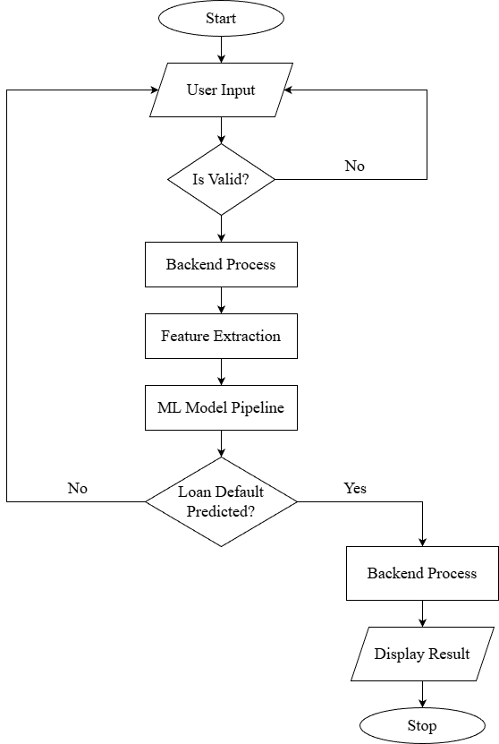
FLOW DIAGRAM
Figure 1.1 : System Flow of the Loan Default Prediction System
Department of MCA, VCET Puttur

Slide 12
PROJECT CARRIED OUT
Methodology
User enters borrower details into the system.
Input data is validated and processed.
Machine learning model predicts loan default risk.
Final result is calculated and displayed to the user.
Department of MCA, VCET Puttur

Slide 13
PROJECT CARRIED OUT
Modules Developed
Flask
MYSQL
Random Forest
Logistic regression
LightGBM
Challenges Faced
Data Quality Issues – Missing or incorrect data
Imbalanced Dataset – Fewer default cases than non-default
Model Accuracy – Difficulty achieving high accuracy
Feature Selection – Choosing important factors
Overfitting – Model works well on training but not on new data
Department of MCA, VCET Puttur

Slide 14
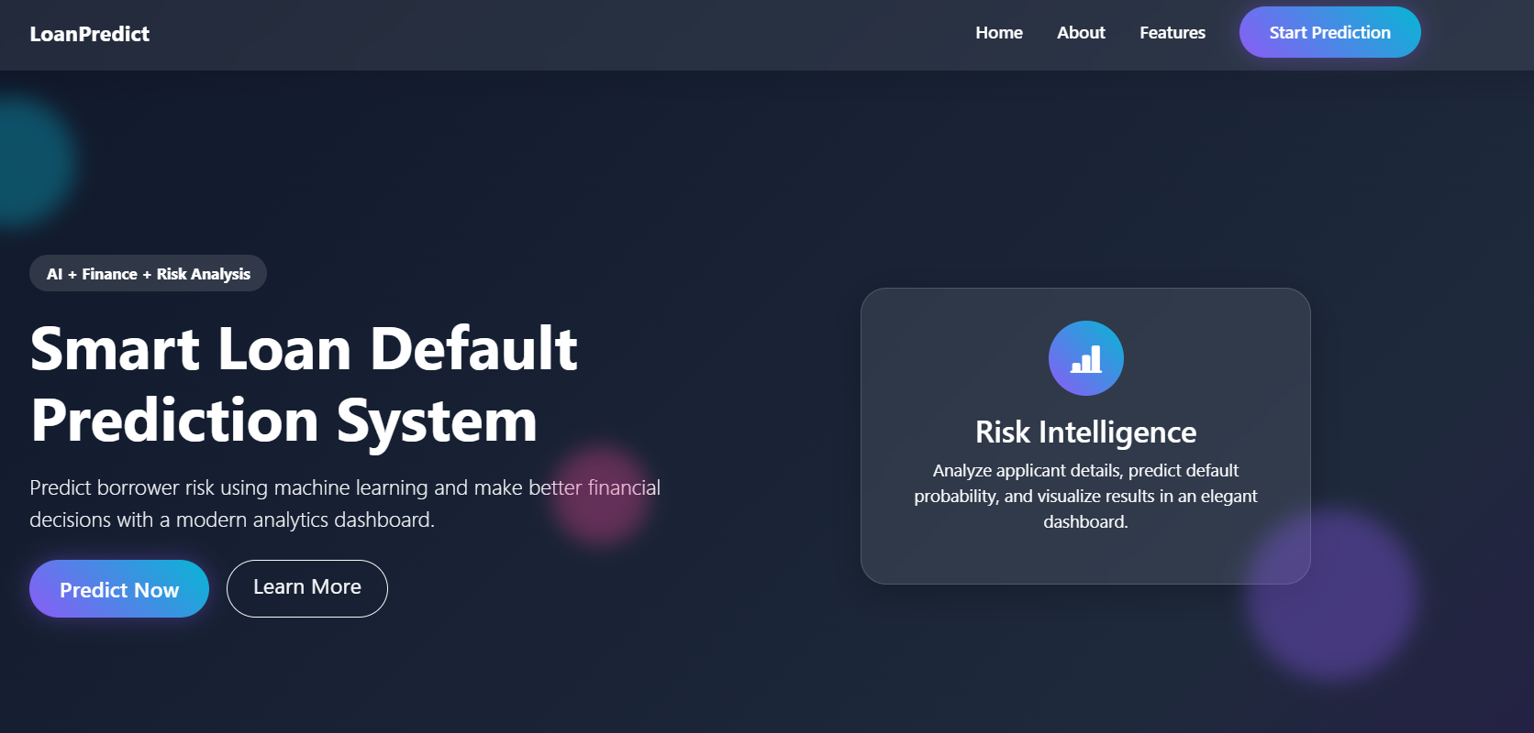
PROJECT CARRIED OUT
Figure 1.2 : Home Page
Department of MCA, VCET Puttur

Slide 15
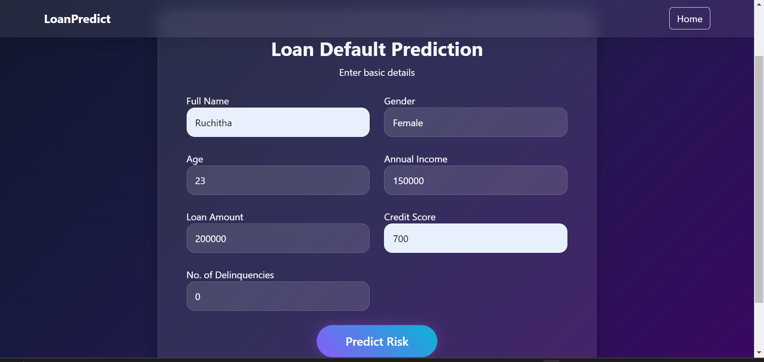
PROJECT CARRIED OUT
Figure 1.3 : Loan Default Prediction Input Form
Department of MCA, VCET Puttur

Slide 16
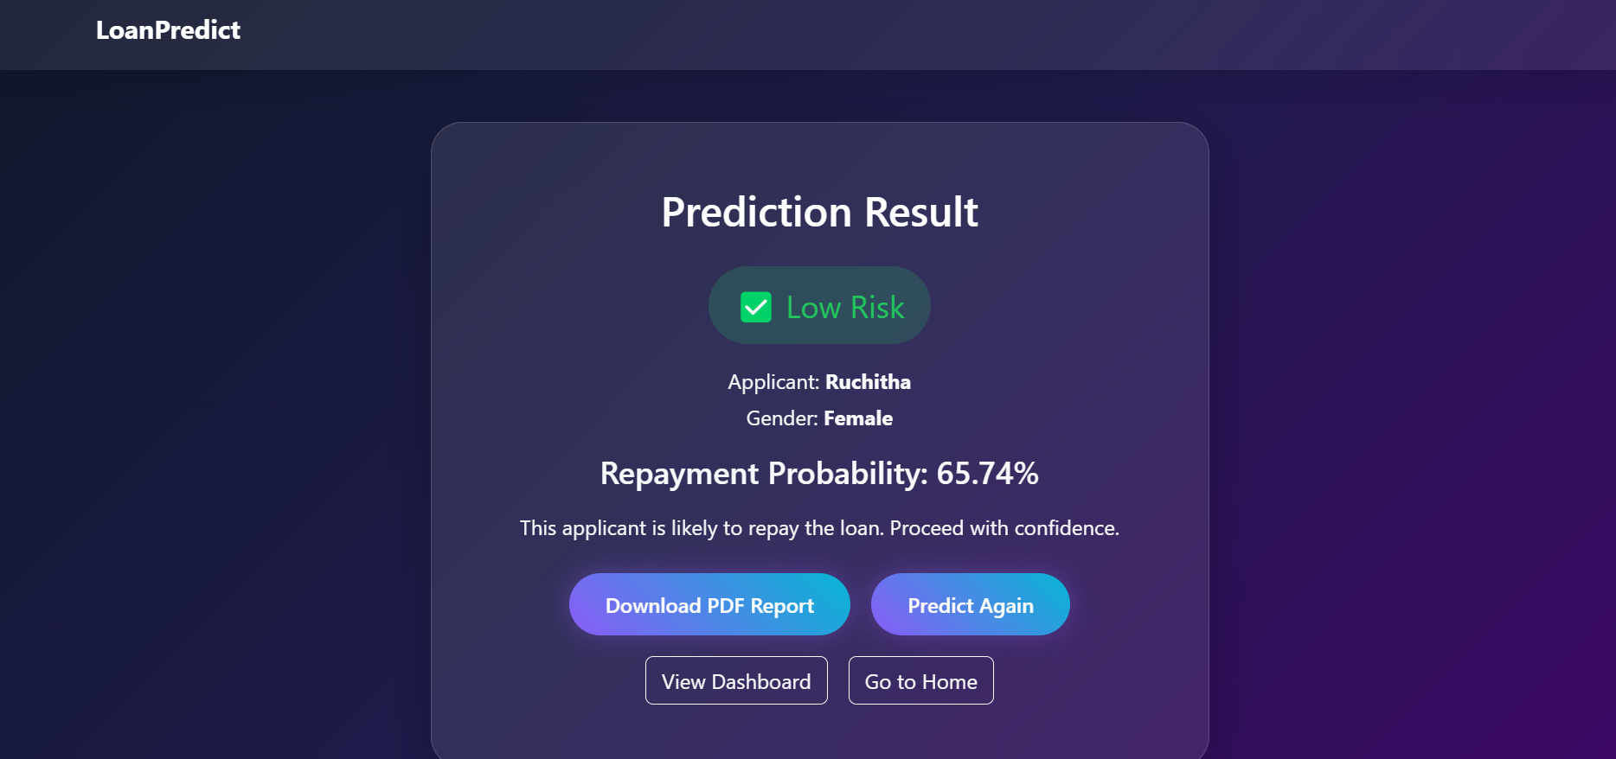
PROJECT CARRIED OUT
Figure 1.4 : Loan Default Prediction Result Page
Department of MCA, VCET Puttur

Slide 17
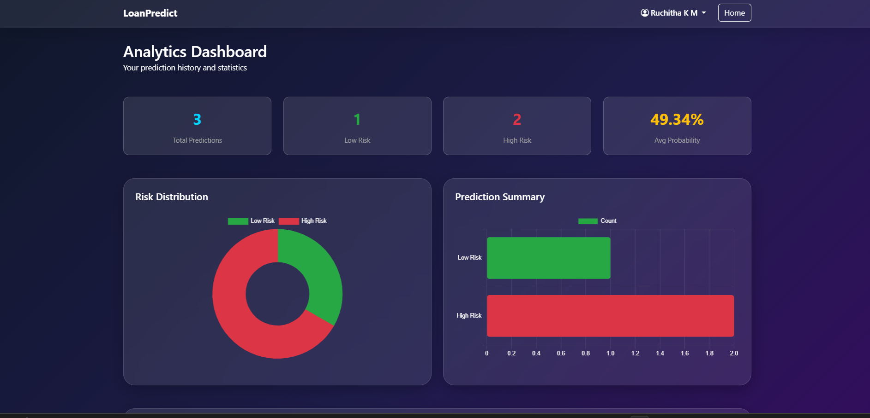
PROJECT CARRIED OUT
Figure 1.5 : Loan Risk Prediction Analytics Dashboard
Department of MCA, VCET Puttur

Slide 18
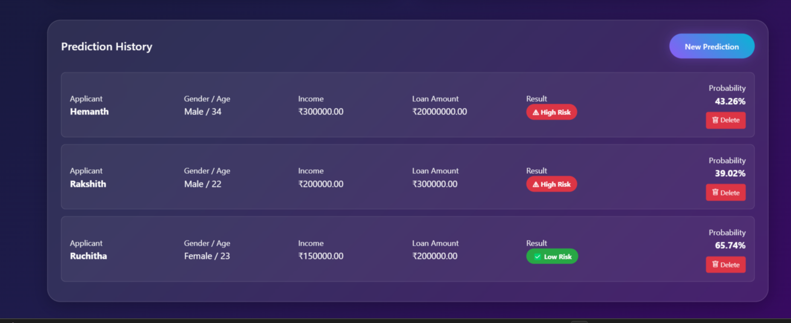
PROJECT CARRIED OUT
Figure 1.5 : Loan Risk Prediction History Page
Department of MCA, VCET Puttur

Slide 19
CONCLUSION
The Loan Default Prediction System helps identify whether a customer is likely to default using machine learning algorithms.
It improves decision-making, reduces financial risk, and saves time for banks. With proper data and high model accuracy, the system can provide reliable and fast predictions.
The system uses machine learning to quickly and accurately assess borrower risk, enabling banks to make better lending decisions and reduce financial losses.
Department of MCA, VCET Puttur

Slide 20
THANK YOU
Department of MCA, VCET Puttur

